Slide 1
Boolean Functions

Slide 2
Boolean function
Boolean algebra is an algebra that deals with binary variables and logic operations.
A Boolean function described by an algebraic expression consists of binary variables, the constants 0 and 1, and the logic operation symbols.
For a given value of the binary variables, the function can be equal to either 1 or 0.

Slide 3
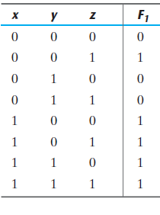
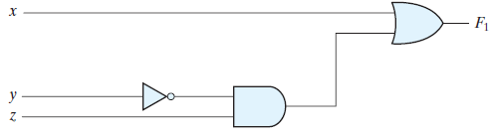
Boolean Functions
Consider the following Boolean function:
F₁ = x + y’z
A Boolean function can be represented in a truth table. The binary combinations for the truth table are obtained by counting from 0 through 2^{n}-1 see 0 to 7.

Slide 4
Simplification of Boolean Functions
There is only one way that a Boolean function can be represented in a truth table.
In algebraic form, it can be expressed in a variety of ways and all of them have equivalent logic.
The particular expression used to represent the function will dictate the interconnection of gates in the logic‐circuit diagram. Conversely, the interconnection of gates will dictate the logic expression.

Slide 5
Simplification of Boolean Functions
Here is a key fact that motivates our use of Boolean algebra: By manipulating a Boolean expression according to the rules of Boolean algebra, it is sometimes possible to obtain a simpler expression for the same function and thus reduce the number of gates in the circuit and the number of inputs to the gate.
Designers are motivated to reduce the complexity and number of gates because their effort can significantly reduce the cost of a circuit.

Slide 6
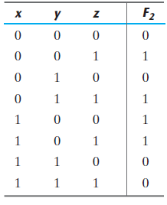
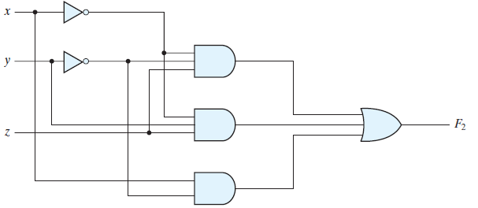
Before simplification of Boolean function
Consider the following Boolean function:
F₂ = x’y’z + x’yz + xy’
This function with logic gates is shown in Fig. The function is equal to 1 when xyz = 001 or 011 or when xyz = 100,101 .

Slide 7
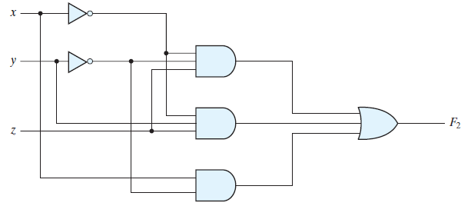
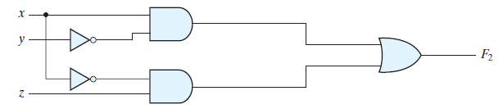
After simplification of Boolean function
Simplify the following Boolean function:
F₂ = x’y’z + x’yz + xy’
= x’z (y’ + y) + xy’
= x’z + xy’
The Reduced function would be preferable because it requires less wires and components.
simplified

Slide 8
Equivalent Expressions
F₂ = x’y’z + x’yz + xy’(primitive)
F₂=1 when xyz=001 or 011 or when xy=100,101
F₂ = x’z + xy’
F=1 when xz=01 or when xy=10
(simplified)
Since both expression produce the same truth table, they are said to be equivalent.

Slide 9
Therefore, the two circuits have the same outputs for all possible binary combinations of inputs of the three variables.
Each circuit implements the same identical function, but the one with fewer gates and fewer inputs to gates is preferable because it requires fewer wires and components.
In general, there are many equivalent representations of a logic function. Finding the most economic representation of the logic is an important design task.

Slide 10
Algebraic Manipulation
When a Boolean expression is implemented with logic gates, each term requires a gate and each variable within the term designates an input to the gate.
We define a literal to be a single variable within a term, in complemented or uncomplemented form.

Slide 11
F₂ = x’y’z + x’yz + xy’ has three terms and eight literals
F₂ = x’z + xy’ has two terms and four literals
By reducing the number of terms, the number of literals, or both in a Boolean expression, it is often possible to obtain a simpler circuit.
The manipulation of Boolean algebra consists mostly of reducing an expression for the purpose of obtaining a simpler circuit.

Slide 12
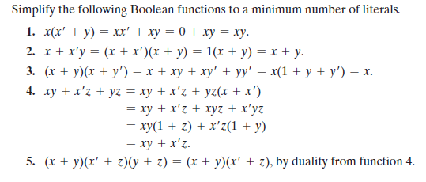
Simplification of Boolean functions

Slide 13
Simplification of Boolean functions
The fourth function illustrates the fact that an increase in the number of literals sometimes leads to a simpler final expression.
Function 5 is not minimized directly, but can be derived from the dual of the steps used to derive function 4.
Functions 4 and 5 are together known as the consensus theorem.

Slide 14
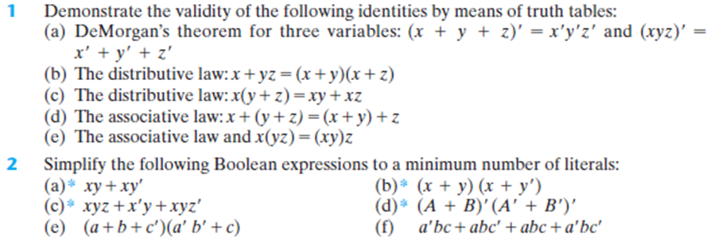
Assignment

Slide 15
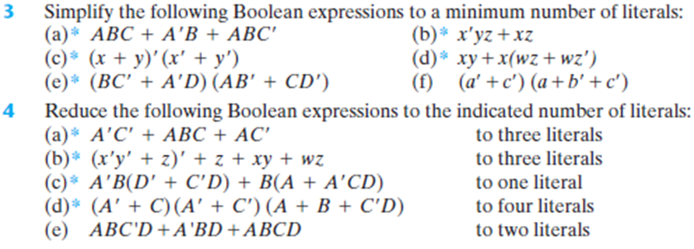
Assignment

